Slide 1

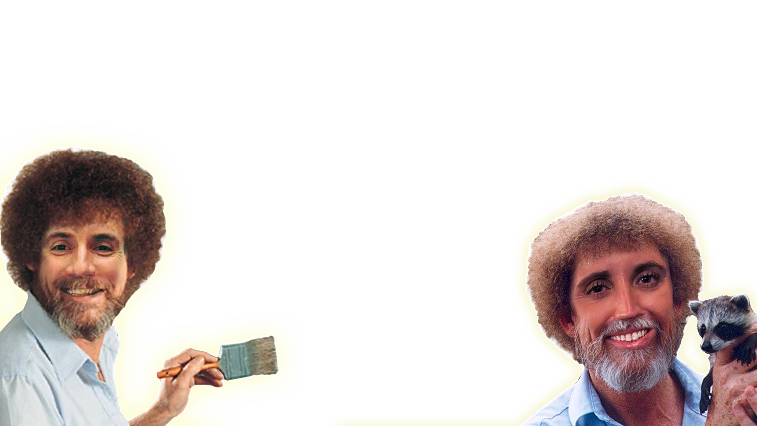
Lesson
FOUR
Working with our nav and
injecting stuff from Codepen.
Jacob L. Buller
(Not a developer)
Kasey A. Stolba
(An actual developer)

Slide 2
What we’re doing…
More work with Bootstrap, Codepen, and some styling as well. We’ll also cover icons briefly.
We’re going to:
Update the navigation
Update the gallery and add some cool effects
Update the footer
Make some style adjustments
For this lesson we’re going to build off what we did in the last lesson! So you can either open the file you worked on before, or download it from github - https://github.com/jcbbuller/building-with-jasey/tree/Lesson-4

Slide 3
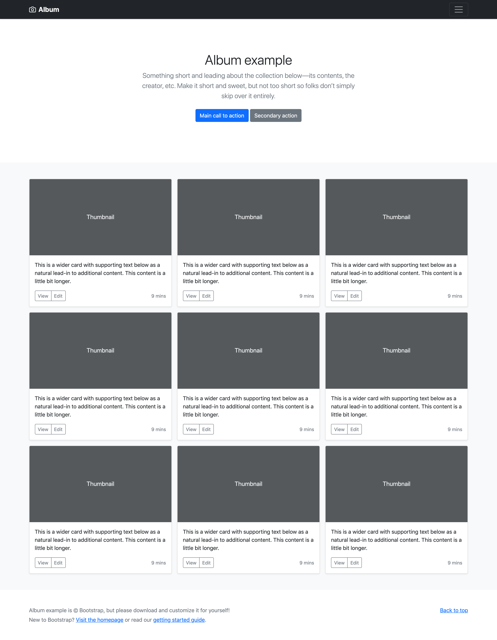
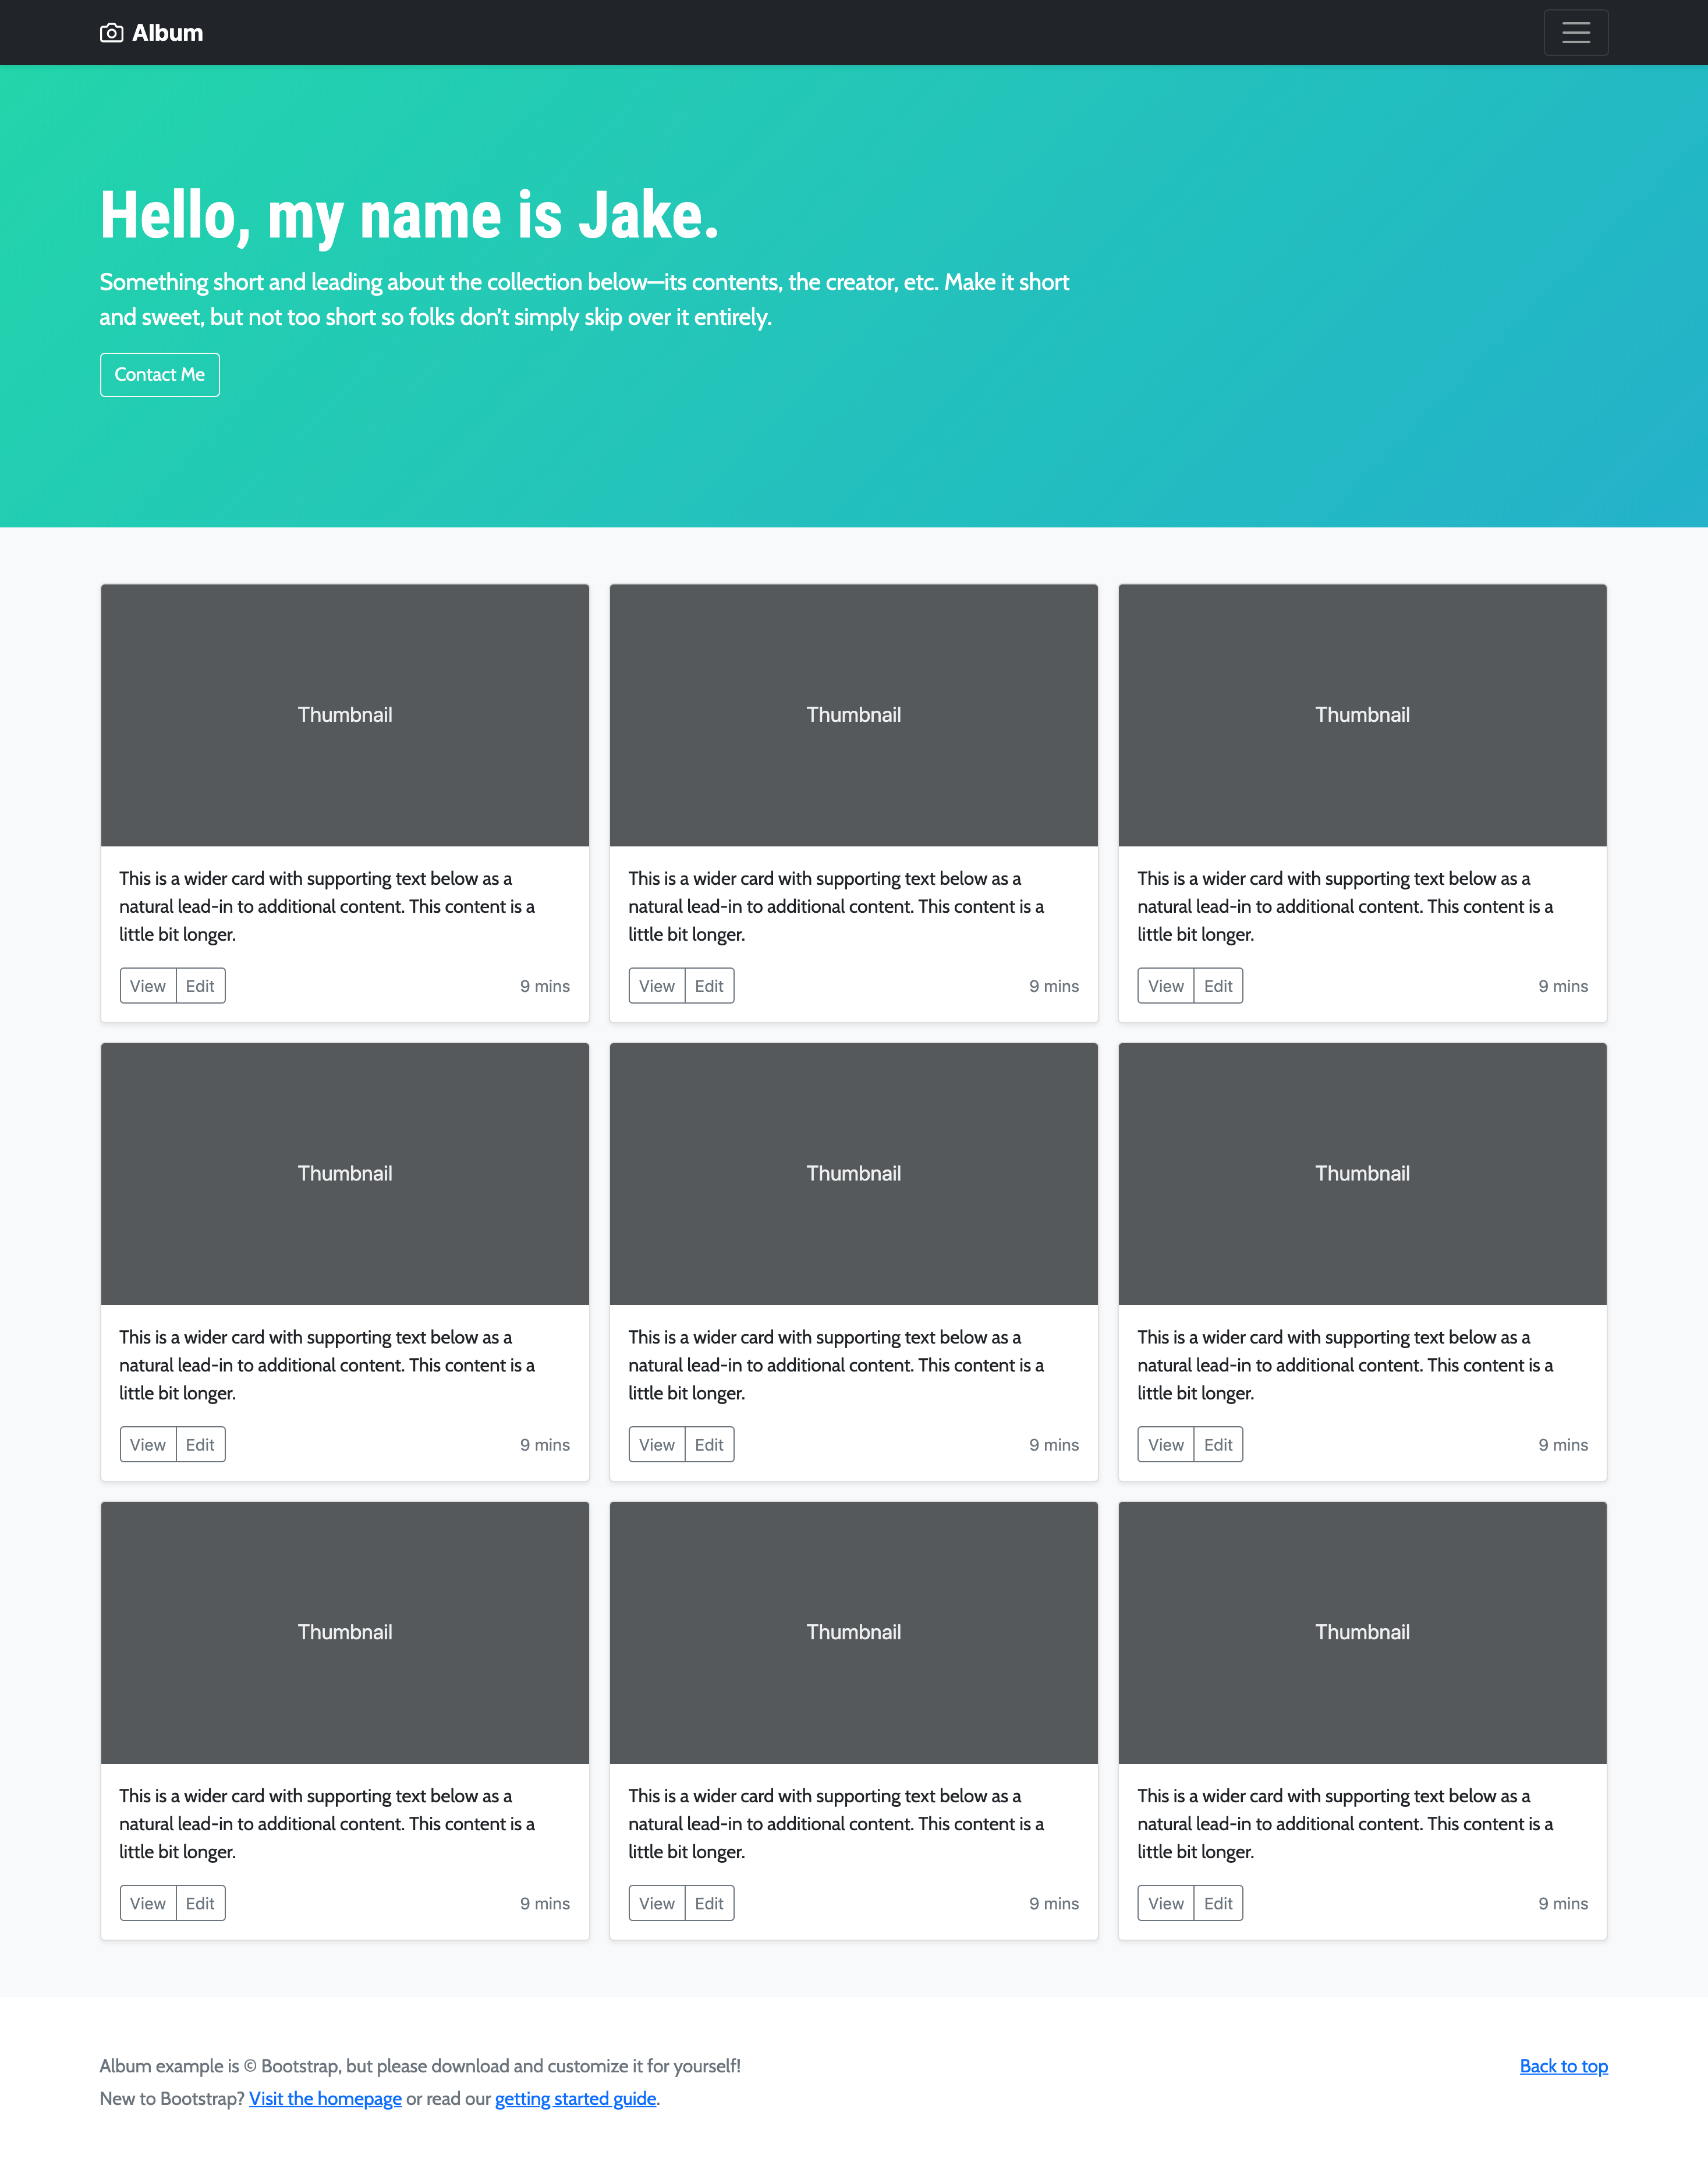
Before
After

